Slide 1

ELECTRONICS AND COMMUNICATION ENGINEERING Customer Relationship Management Improvement using IoT Data By BEDTURI ASWINI (202G1A04C9) SHAIK JAHIDA (202G1A04G7) JUTURU BAKTHAR VALI (202G1A04D9) VALASA REDDAPPA REDDY (212G5A0430) SAMAPNGI BHARGAVA (202G1A04G5) Under the Esteemed guidance of Dr C. ARUNA BALA MTech., Ph.D Professor in ECE, ALTS

Slide 2
CONTENTS
Abstract
Introduction
Existing methods
Drawbacks
Proposed methods
Block diagram
Advantages
Tools used
Results
Conclusion

Slide 3
Abstract
Internet of things facilitates relationships in the business world. With the increased usage of new Internet services in the country and with respect to the intense competition between businesses, these organizations should pay special attention to customer relationship management in order to survive and grow in the market.
The Internet has become the main tool for information exchange, businesses, communication, and an integral part of daily life. Having an effective relationship with the customers is the most important key to success in any business. About these relationships, it can be said that companies use social mediain order to directly contact with customers.

Slide 4
Introduction
Due to technological developments and increasing in inter-connectedness of the world population, the Internet of Things(IoT) becomes reality. Devices such as smartphones, household appliances, machines, vehicles, and people or even entire cities are increasingly connected to the internet.
IoT can fundamentally change the way of interaction between humans and their environment.
Having an effective relationship with the customers is the most important key to success in any business.
The connection of user to the internet data exchanging and relations between things through sensors and tags has created a network of things, able to communicate anywhere and anytime.

Slide 5
Existing Methods
Standardized CRM Systems: Companies typically implement off-the-shelf, standardized CRM systems to manage customer relationships and data.
Data Aggregation: IoT data collected from individual customers is aggregated with other customer data already present in the CRM system, such as purchase history, customer support interactions, and marketing campaign responses.
Holistic Customer Understanding: By aggregating data from various sources, including IoT devices, companies aim to gain a comprehensive understanding of customer behavior, preferences, and needs related to the products or services they offer.
Marketing Alignment: Based on the holistic customer understanding derived from the aggregated data, companies can align their marketing activities and strategies to better target and engage with customers.

Slide 6
Drawbacks :
It is very difficult to plan, build, manage, and enable a broad technology to IoT framework.
Deploying IoT devices is very costly and time consuming.
CRM may not suitable all businesses.

Slide 7
Proposed Methods
Data Collection: Utilize IoT devices to collect real time data on customer interactions and product usage.
Proactive services: Use IoT data to predict potential issues and address them proactively improving customer service and support.
Continuous Improvement : Regularly update the CRM system to incorporate new IoT technologies and data sources.

Slide 8
Block Diagram Customer Relationship Management Improvement using IoT Data
Arduino
UNO
16*2 LCD
Power Supply
Buzzer
RFID Reader
IOT
Tags

Slide 9
RFID reader: It is a device that reads RFID tags and gathers data about the connected object. It can be both wired and wireless.
16*2 Display : The display is 16 character by 2 line display has a very clear and high contrast white text upon a blue background/backlight.
BUZZER :It is a simple yet effective component used for auditory notifications or alarms. It can be integrated into IoT devices to alert users about certain events
IOT : systems presents exciting opportunities for businesses to gather real-time data, improve customer engagement, and deliver personalized experiences.
Arduino Uno: it's a popular microcontroller board often used in electronics projects for prototyping and creating various devices.

Slide 10
Benefits of CRM
ADVANTAGES
The CRM advance the good communication channels.
It recognizes the modern opportunities of selling.
Improved Sales Opportunity
Enhanced Customer Services
Real Time Data Insights
Product and Service Innovation

Slide 11
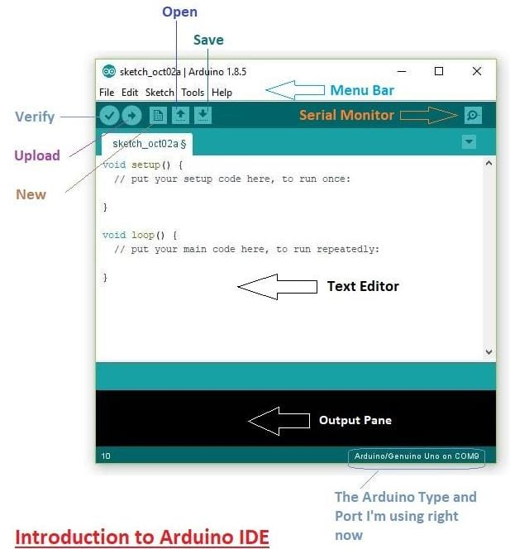
Software Tools : Arduino software IDE :The Arduino Integrated Development Environment – or Arduino Software (IDE)contains a text editor for writing code. Proteus ISIS : Proteus is a simulation and electronic design development tool.

Slide 12
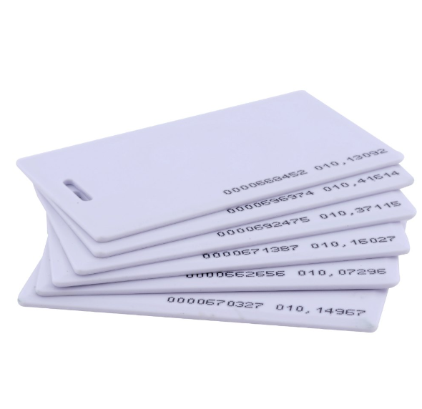
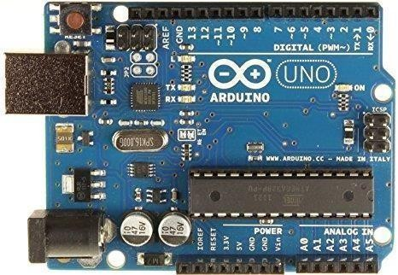
Hardware Tools : Arduino UNO : Arduino UNO has 14 digital input/output pins, 6 analog inputs. RFID tags : A Radio Frequency Identification (RFID) tags are small devices which use radio frequencies to transmit data. Fig: Arduino UNO Fig: RFID tags

Slide 13
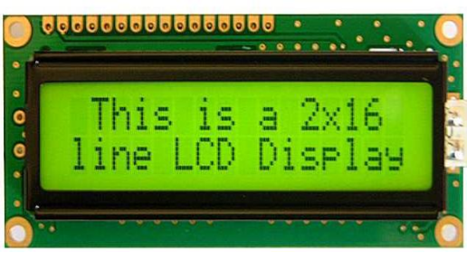
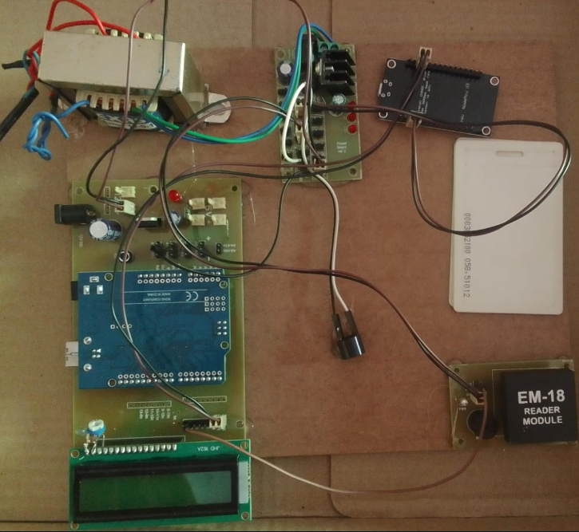
RESULTS
Figure: 2*16 LCD Display
Figure: CRM Kit

Slide 14
CONCLUSION
CRM can bring numerous benefits to businesses, including improved customer satisfaction, increased customer retention, better communication, customer relationship management costly more efficient sales processes, and enhanced marketing efforts. Business is an ongoing process that has to update itself with time (adopt new technologies) to remain in the competition. Before technology, customer data or CRM was based on papers, but slowly, companies started tracking customer-related data with spreadsheets, emails, address books, and other ways.

Slide 15
THANK YOU…

